Slide 1
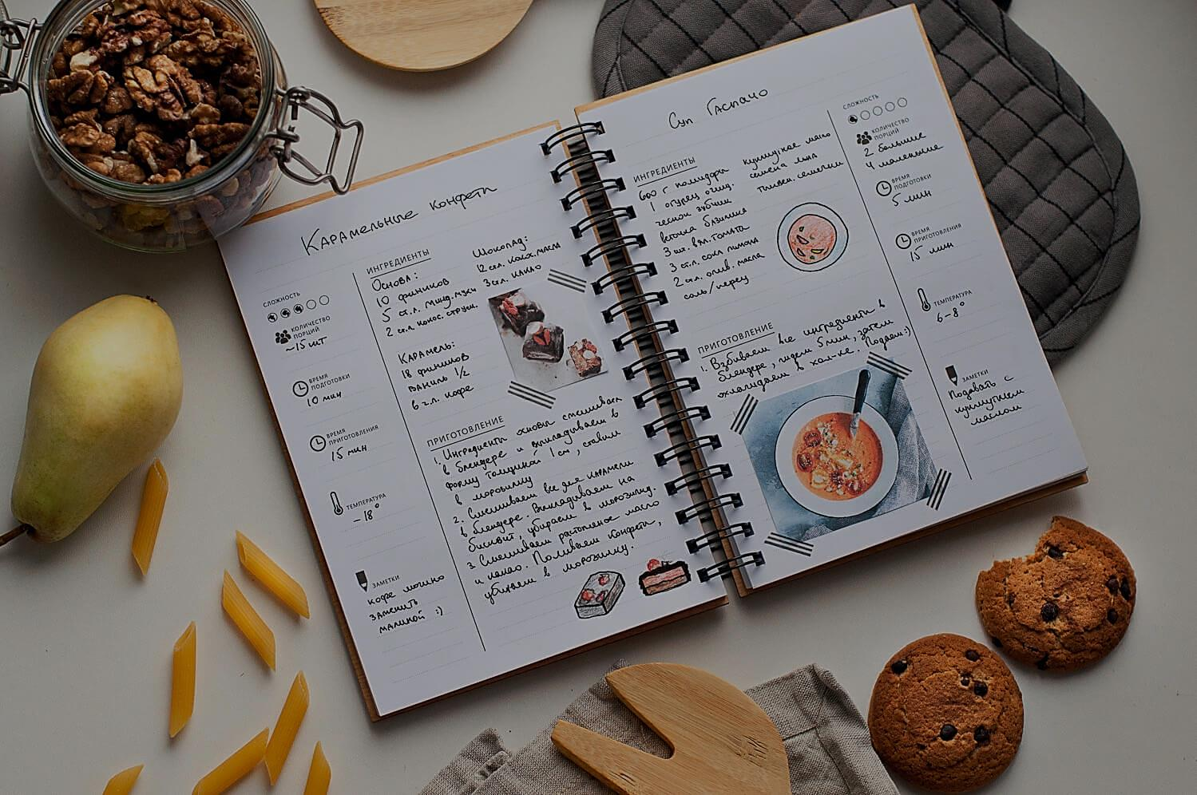
DelDish
Student:
Daniyar Yusupov
Group: ITNSA-1901

Slide 2

Description
DelDish(delicious dish) is a web-based recipe handbook for step-by-step cooking recipes that will help you prepare a wide variety of dishes with ease and interest.
I chose this topic because I found fast and accessible cooking very interesting.

Slide 3
Relevance
Recipe websites remain relevant to this day because:
Fast recipe availability
Comprehensibility
The need for minimal cooking skills
Step-by-step cooking instructions

Slide 4
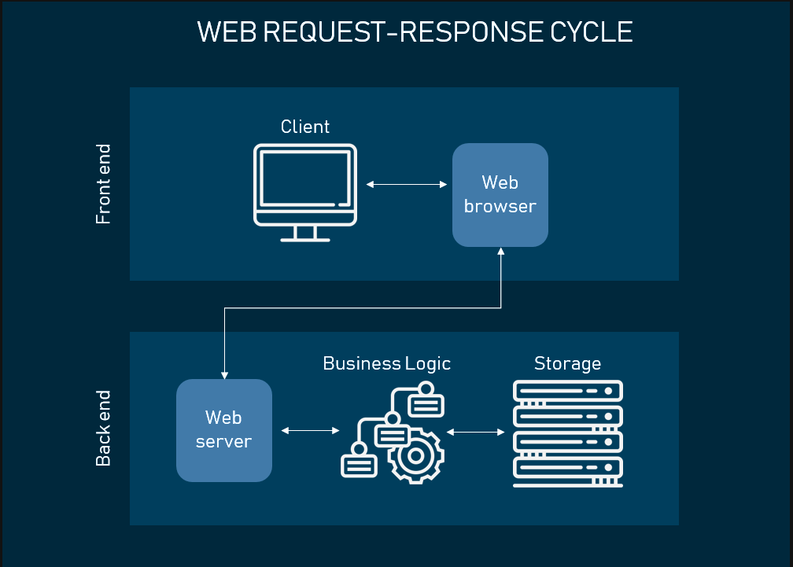


Team members
Front end:
Yusupov Daniyar
Back end:
Yusupov Daniyar
Aldabekova Guldana

Slide 5
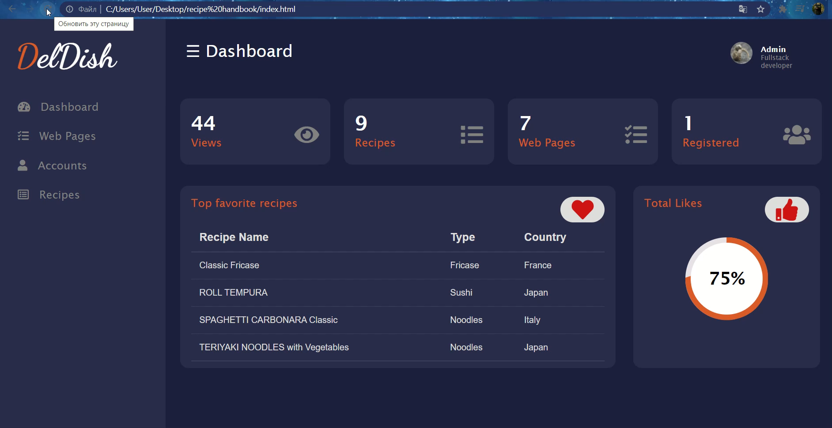
My project contains next pages:
Home, About, Recipes, Contacts, Accounts
Log in, Sign up, Admin dashboard, Recipe example
Features
(Admin dashboard)

Slide 6
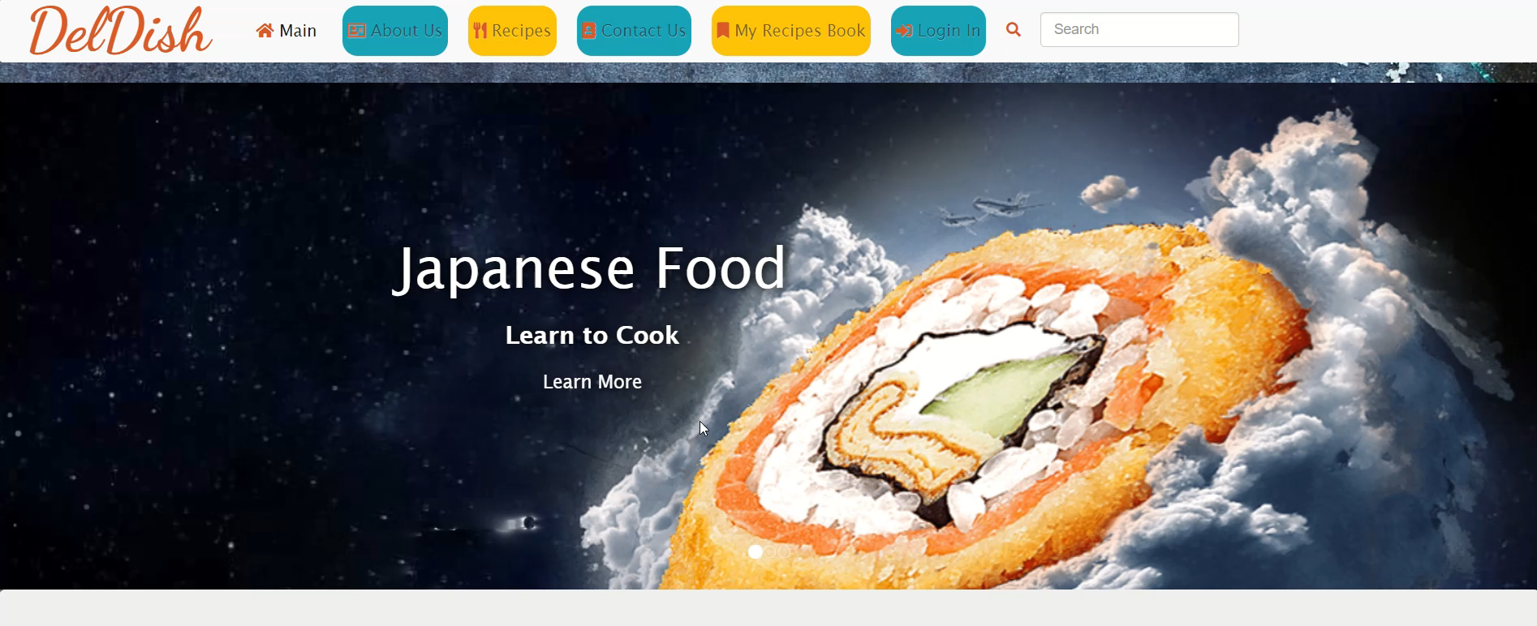
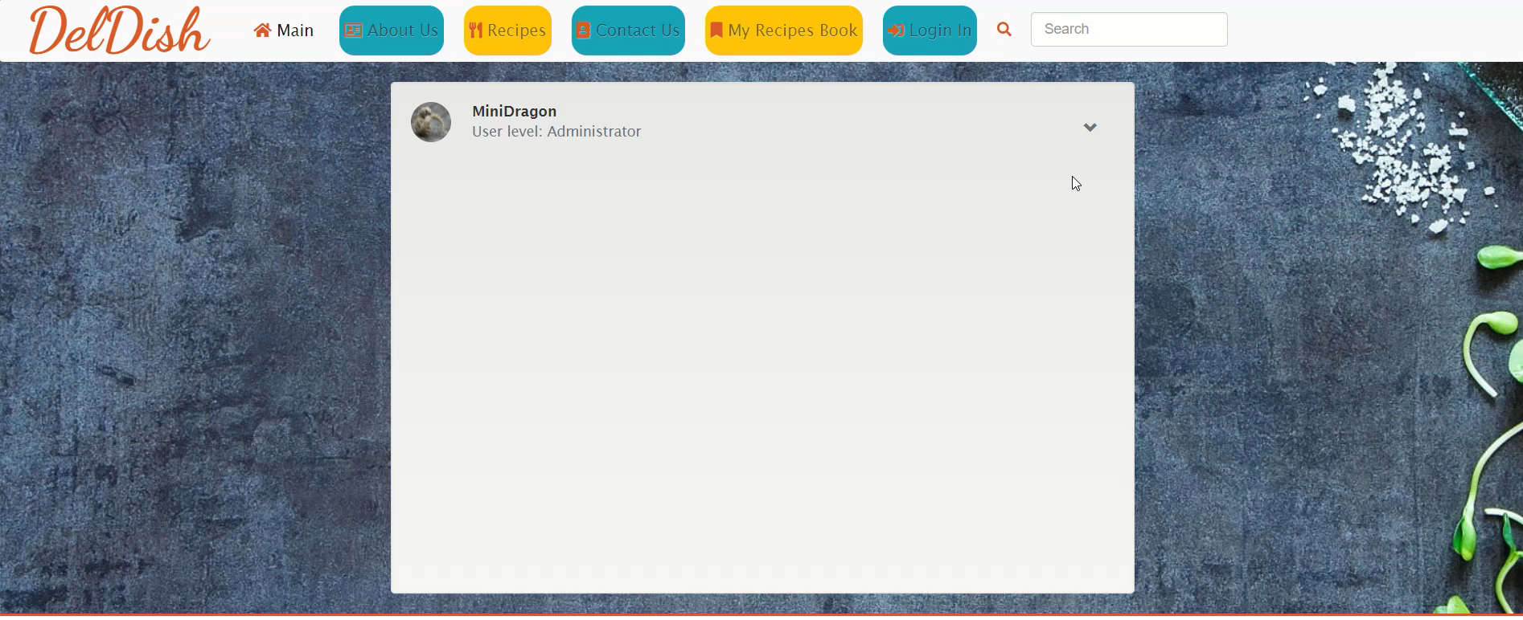

Features
(Menu Slider)

Slide 7
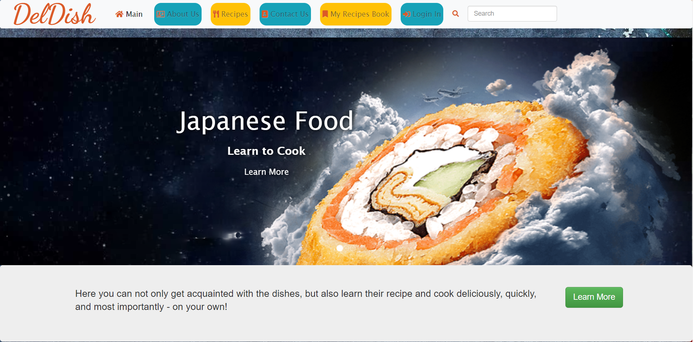
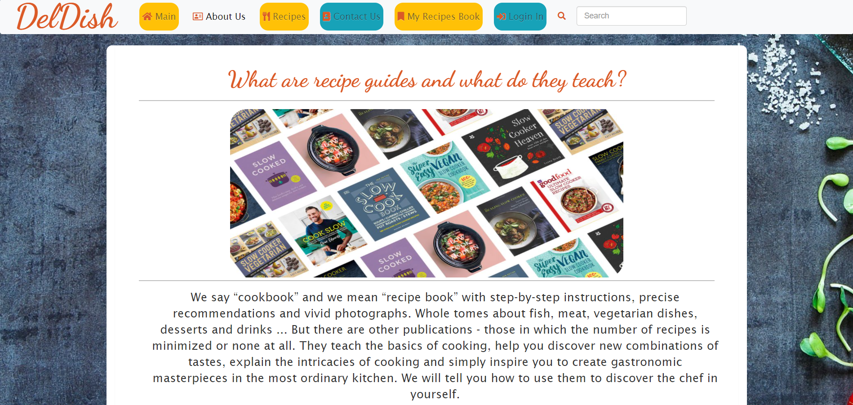

Project Demonstration
Main page
Contains a slider and short info bar with button
About
Contains more description about recipe handbook

Slide 8
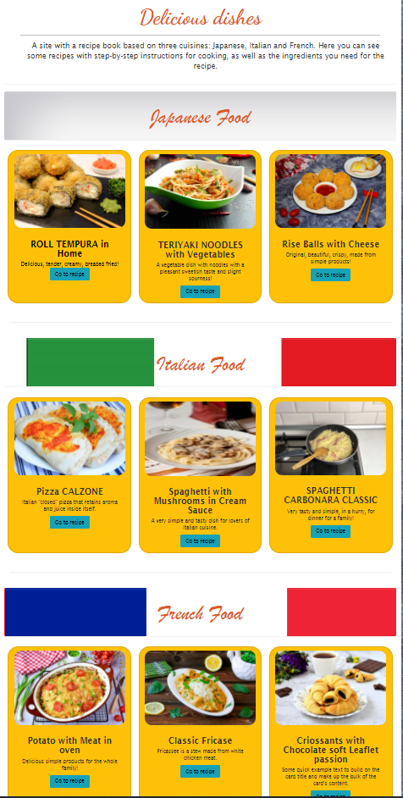
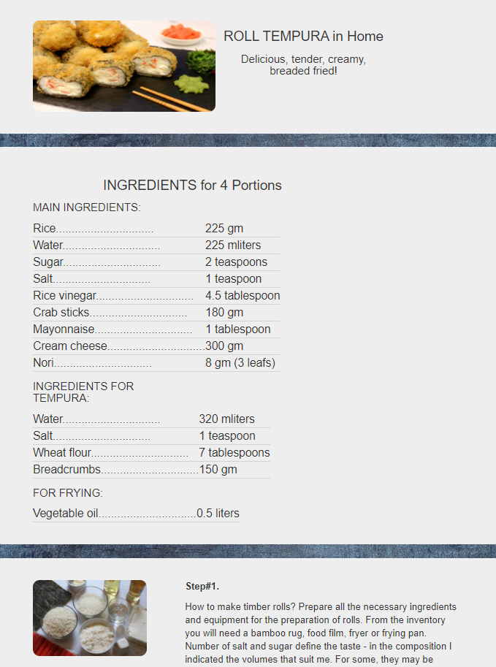
Recipes
Contains 3 blocks of dishes in 3 different cuisines
1st Recipe
Example of step-by-step recipe guide with components and photos

Slide 9
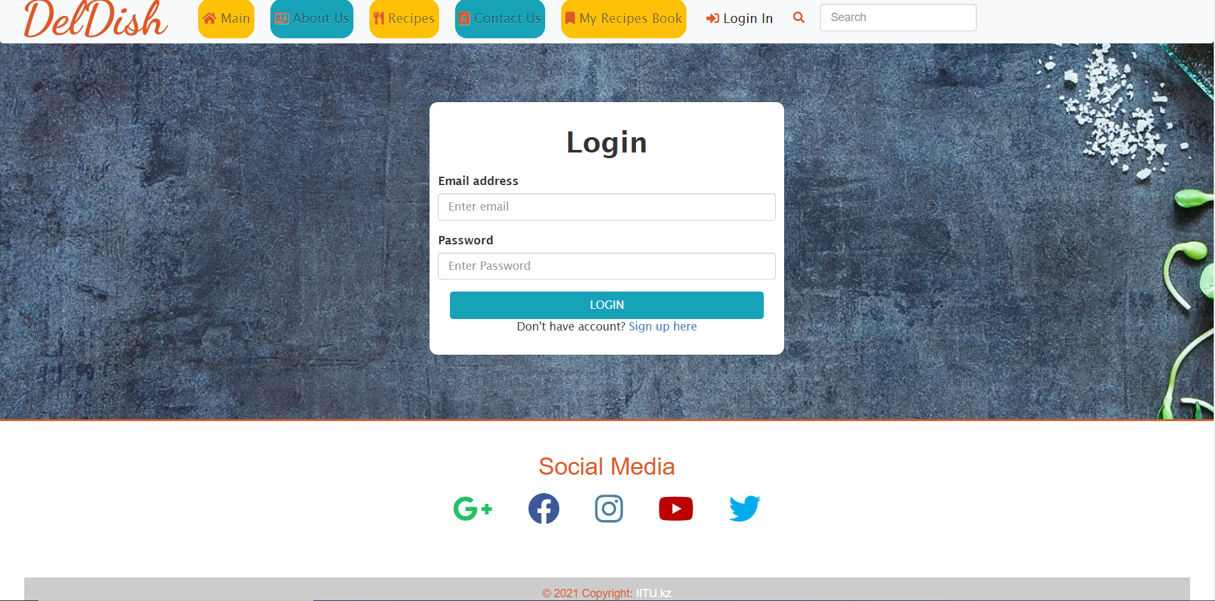
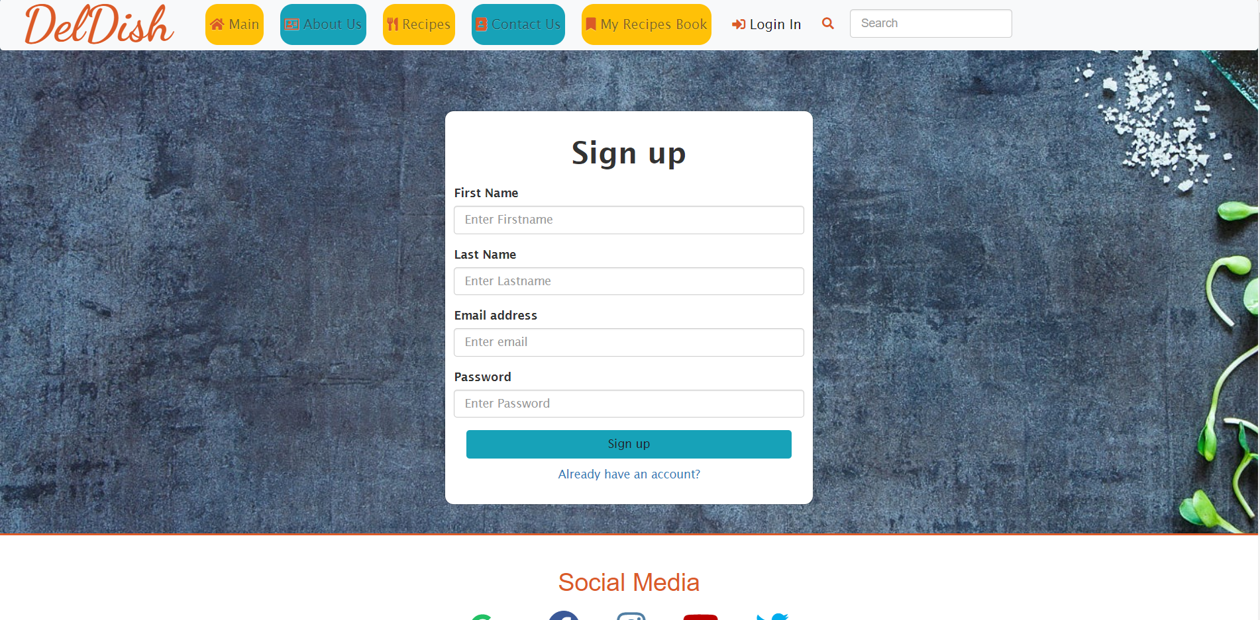
Log in
Contains a login block with email and password fields, “Login” button with link on admin dashboard, link to sign up page.
Sign up
Contains some fields for registration and link to log in page.

Slide 10
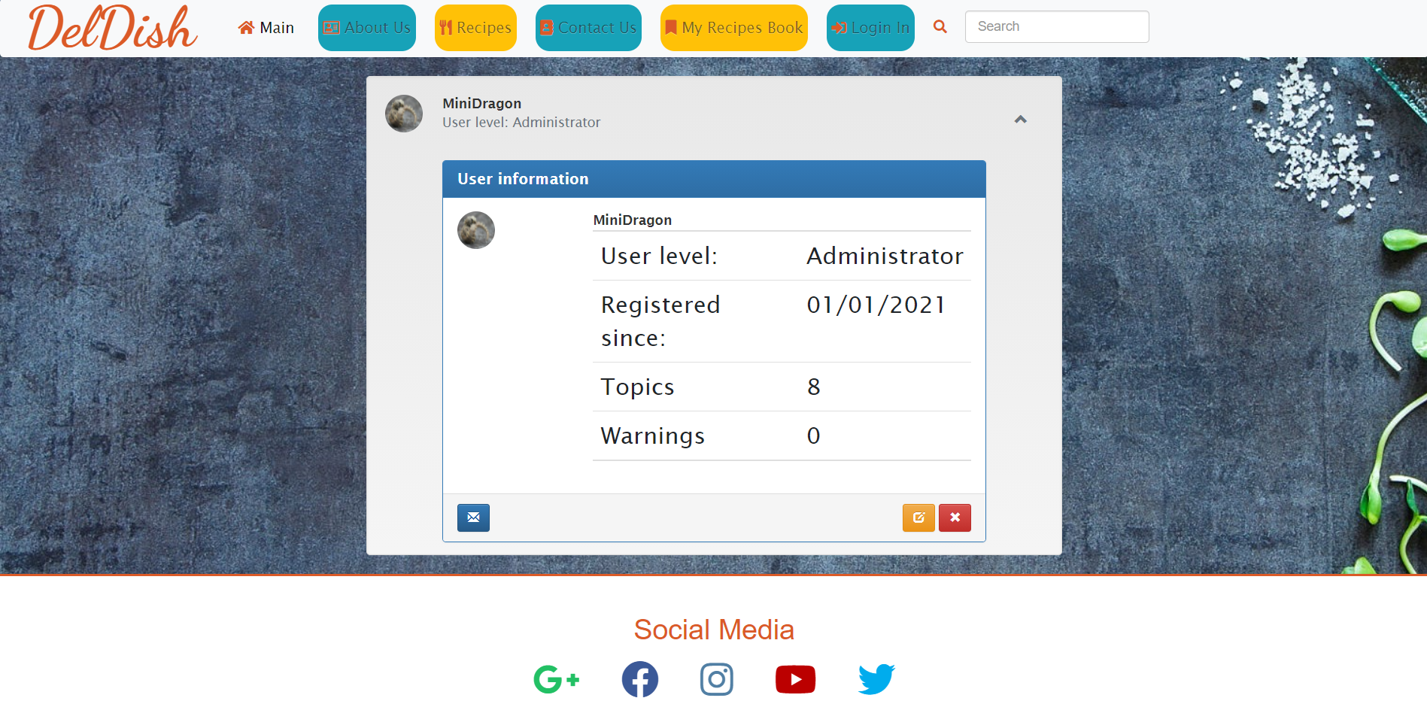
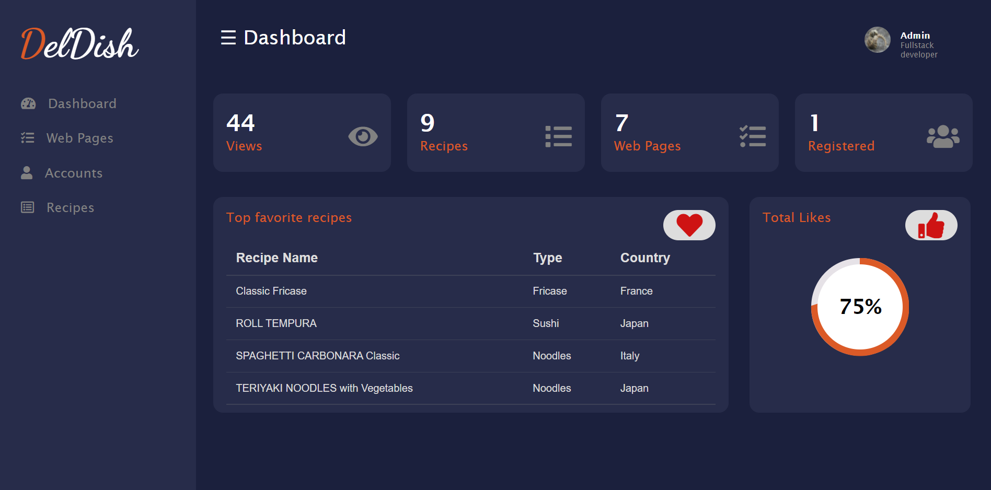
Accounts
Contains all accounts that we have to see.
Admin dashboard
Contains some data about views, count of recipes, count of webpages, accounts, top recipes and total likes diagram.

